Slide 1


Is Fault-Tolerant Adiabatic Quantum Computation Possible?
Dave Bacon
Department of Computer Science & Engineering
University of Washington
sQuINt 2007

Slide 2

“P” Wave
Journalists Says: “Quantum computers, on the other hand, can evaluate all possible solutions simultaneously and find the optimal solution, often in just a few clock cycles, thereby not only vastly speeding up the time taken to find the solution but also finding the most optimal result.”
Question: Will we build a quantum
computer before or after we
run out of SQUINT spellings?
squint
squinT
squiNt
squiNT
squInt
squInT
squINt
squINT
sqUint
sqUinT
sqUiNt
sqUiNT
sqUInt
sqUInT
sqUINt
sqUINT
sQuint
sQuinT
sQuiNt
sQuiNT
sQuInt
sQuInT
sQuINt
sQuINT
sQUint
sQUinT
sQUiNt
sQUiNT
sQUInt
sQUInT
sQUINt
sQUINT
Squint
SquinT
SquiNt
SquiNT
SquInt
SquInT
SquINt
SquINT
SqUint
SqUinT
SqUiNt
SqUiNT
SqUInt
SqUInT
SqUINt
SqUINT
SQuint
SQuinT
SQuiNt
SQuiNT
SQuInt
SQuInT
SQuINt
SQuINT
SQUint
SQUinT
SQUiNt
SQUiNT
SQUInt
SQUInT
SQUINt
SQUINT

Slide 3
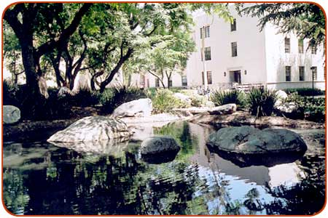
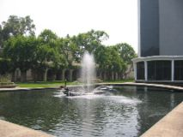
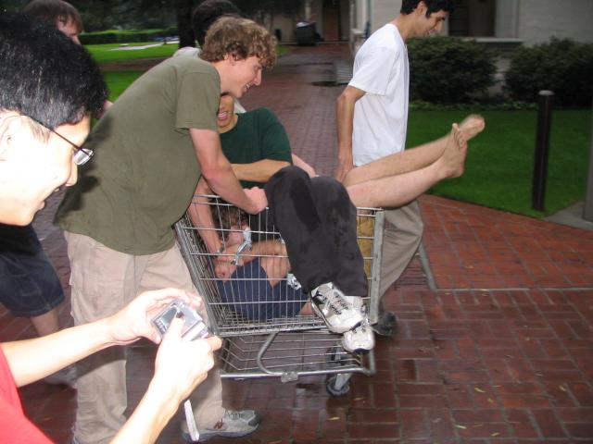
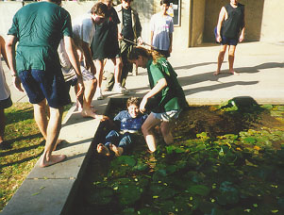
Ponds

Slide 4
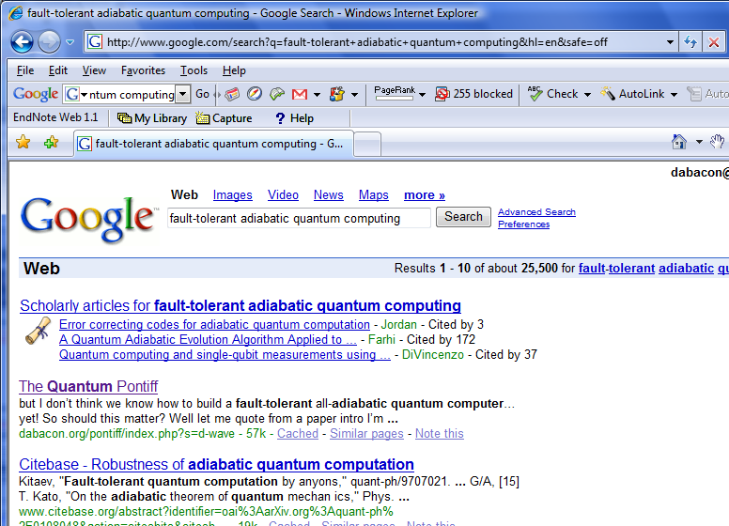
Is Fault-Tolerant Adiabatic Quantum Computation Possible?

Slide 5
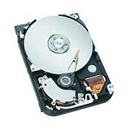


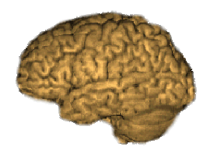
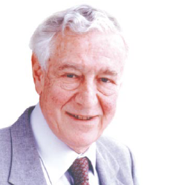

Two Views of Information
Information is “fungible” adj. being of such a nature that one part or quantity may be replaced by another equal part or quantity in the satisfaction of an obligation.
Al Gore
George Bush
Ralph Nader
Pat Buchanan
No Information without Physical Representation!
Not all physical systems are robust
information processing machines
Rolf Landauer

Slide 7




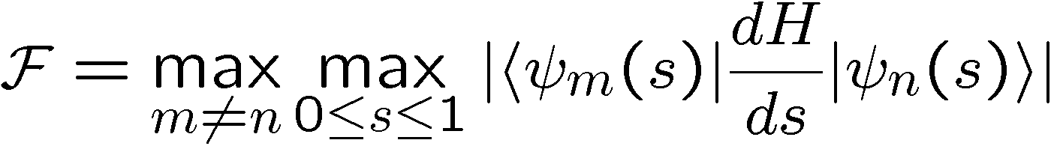
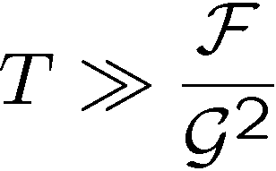
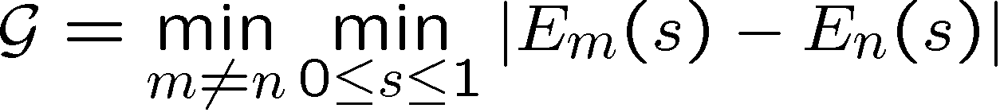
A Beautiful Story
Time dependent Hamiltonian:
energy
time:
Adiabatic condition:

Slide 8



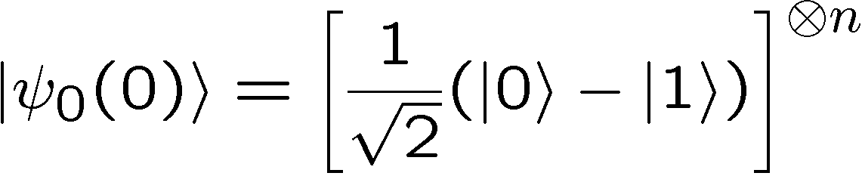
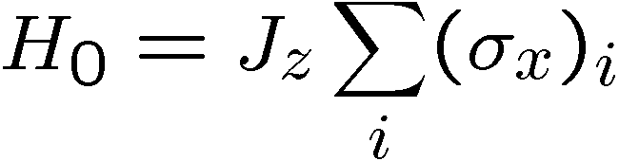
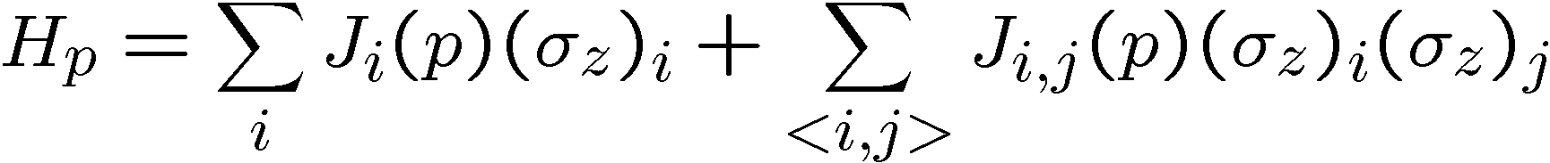
Adiabatic Quantum Algorithms
[E. Farhi, J. Goldstone, S. Gutmann, and M. Sipser, 2000]
1. Prepare ground state of
2. “Slowly” evolve
3. Measure final state, obtaining answer to problem instance p
Example:
Finding ground state of 2D Ising in magnetic field when
bond values are problem instance is NP-complete
[Barahona 82]
Power of adiabatic algorithms? Much Debate!

Slide 9
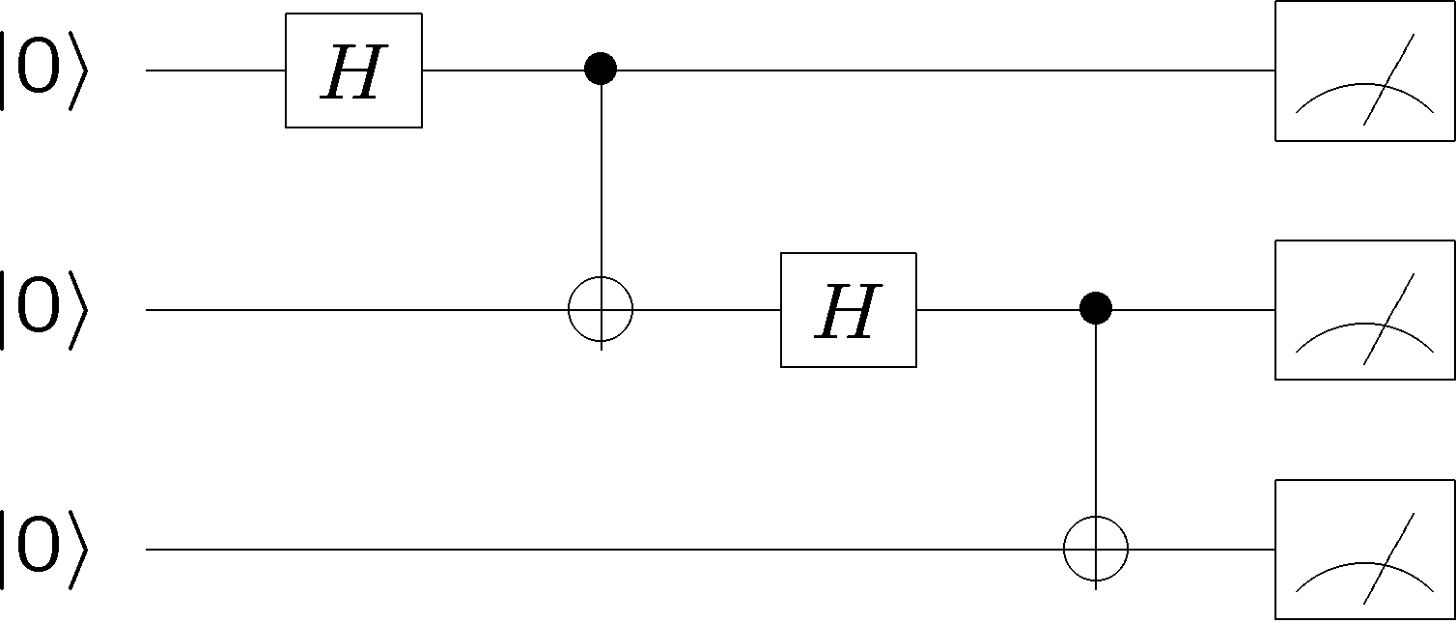



Universal Adiabatic
Quantum Computation
Adiabatic quantum computation ⇔ The quantum circuit model
[D. Aharonov, W. van Dam, J. Kempe, Z. Landau, S. Lloyd, O. Regev, 2004]
state
qubits
clock qubits

Slide 10
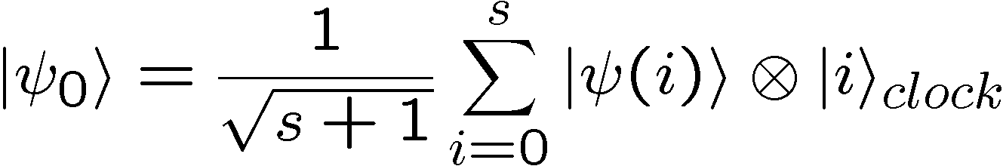
Universal Adiabatic
Quantum Computation
state
qubits
clock qubits
Final ground state is history of circuit:
Pad circuit with identities to boost amplitude of answer
Gap is 1/poly(circuit size)

Slide 11
Towards an Architecture?
3-qubit Hamiltonians, 2-qu6it Hamiltonians on a 2D lattice
[D. Aharonov, W. van Dam, J. Kempe, Z. Landau, S. Lloyd,
O. Regev, 2004]
2-qubit Hamiltonians
[J. Kempe, A. Kitaev, O. Regev, 2004]
2-qubit Hamiltonians in a plane
[R. Oliveira, B. Terhal 2005]
2-body Hamiltonians in a plane with spatial degrees of freedom
[A. Mizel, D.A. Lidar, M. Mitchell 2006]
A new architecture for building a quantum computer?!?!

Slide 12
No Information without Physical Representation!
Rolf Landauer

Slide 13
Count the Ways
1. Preparation may be faulty.
2. Open quantum system, so adiabatic theorem still holds?
3. Open quantum system, so decoherence/noise?
4. Open quantum system, do we have control?
5. Faulty measurement
Is Fault-Tolerant Adiabatic Quantum Computation Possible?

Slide 14
Count the Ways
2. Open quantum system, so adiabatic theorem still holds?
M. S. Sarandy and D. A. Lidar 2005
P. Thunstrom, J. Åberg, and E. Sjöqvist 2005
Open system adiabatic theorems.
The longer you take, the more likely the effects of the
broadening of your energy levels will shrink the gap
and destroy the adiabatic condition.
“Static” Limit reminder: duck shoe thrown by Daniel Lidar

Slide 15







Energetics of Decoherence
system
environment
Perturbative regime:
Perturbative regime: decoherence conserves system and
environment energy (rotating wave approx)
cooling
heating
dephasing
by cooling environment we can eliminate heating

Slide 16
An Early Result
[Childs, Farhi, Preskill 2001]
energy
time:
If bath temperature is much less than energy gap: safe
Problem: Temperature will have to shrink like 1/poly(n)

Slide 17

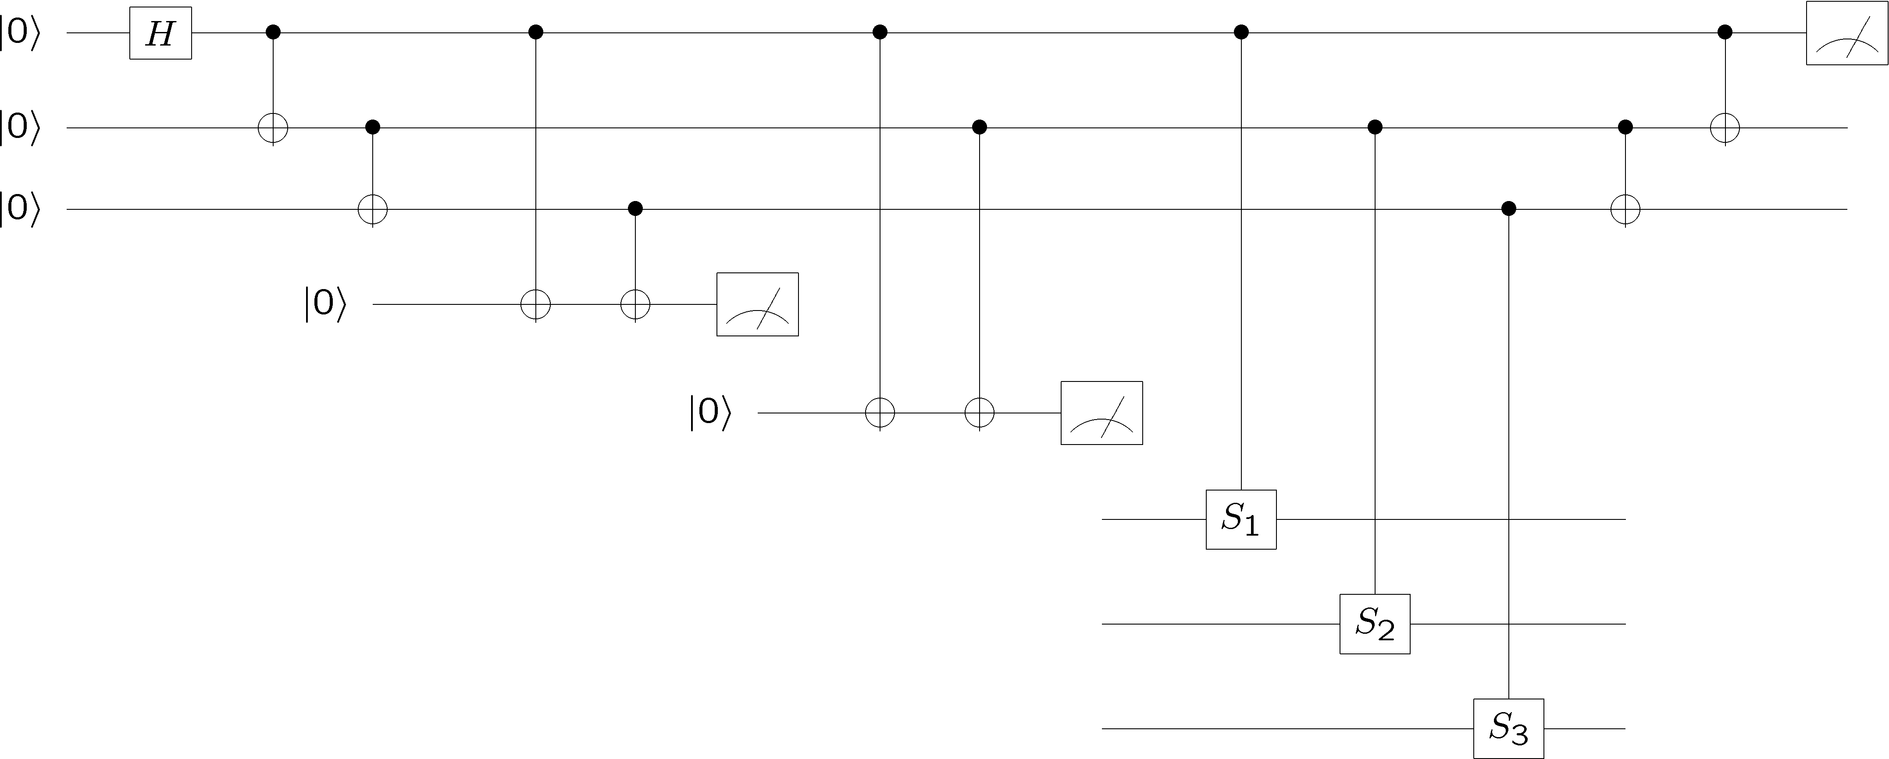
Port?
Standard QEC -> Hamiltonian Form
This can care for certain types of error.
Example: Hamiltonian implements wrong unitary gate

Slide 18
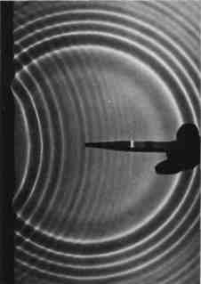
The Puddle
Problem: local error can propagate through network

Slide 19
Lessons of Quantum Error
Correction
Information is in the eye of the beholder
2. Quantum error correction is sophisticated cooling
Quantum Computation
measure
fix error
state
preparation
error
measure, diagnose error
entropy dump
(cool ancillas)
cold ancilla qubits

Slide 20




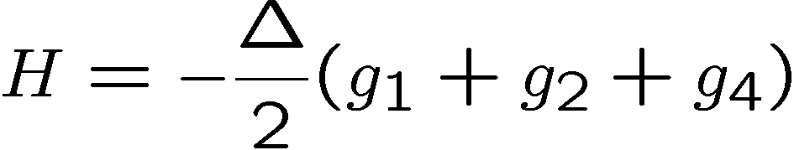
A Later Result
[Jordan, Farhi, Shor 2006]
Stabilizer generators [[4,1,2]] code
Hamiltonian:
All single qubit errors
(X,Y,Z on single qubit)
take ground state to
excited state

Slide 21
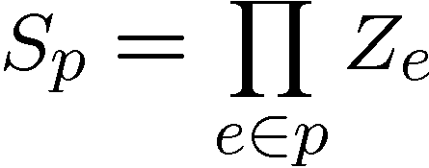
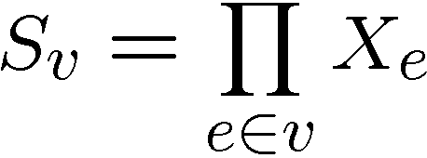
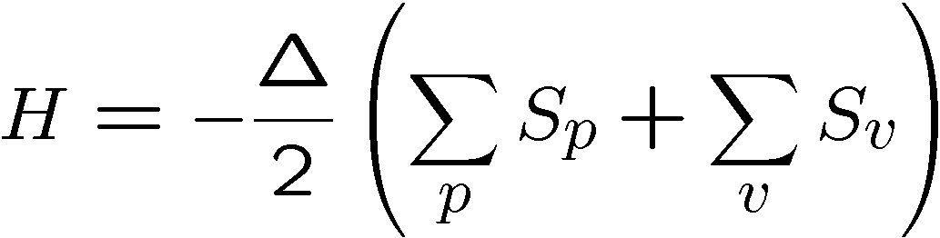



Kitaev’s Model
plaque operators:
qubits on links
vertex operators:

Slide 22

Problemo #1
Jordan, Farhi, Shor 2006
Protect against 1 qubit errors, 3 qubit interactions
To make universal for AQC, 4 qubit interactions
Protect against 2 qubit errors, 4 qubt interactions
To make universal for AQC, 6 qubit interactions
Kitaev’s Toric Codes
Protect against L qubit errors, 4 qubit interactions
To make universal for AQC, 2L qubit interactions

Slide 23


Problemo #2
Geometry:
Stabilizer generators [[4,1,2]] code

Slide 24








Two Qubit Interactions?
1
2
Hamiltonian
ZZ
XX
XX
Quantum error detecting code
3
ZZ
4
Code is a symmetry of the Hamiltonian:
Code detects any single qubit error:
H does not depend on second qubit (use to store encoded qubit)

Slide 25





















ground state is +1 eigenvalue of four qubit interactions

Slide 26

Supercoherence
ALL single qubit errors take degenerate ground state to higher energy levels.
Single qubit errors change value of (S₁,S₂) and hence take ground state to higher energy level.
To first order all single qubit
decoherence becomes heating
FORBIDDEN
Energy gap and low temperature suppress lowest order decoherence
[Bacon, Brown, Whaley 2001]

Slide 27

Two Qubit Encoded Terms?
1
2
5
6
ZZ
ZZ
ZZ
ZZ
XX
XX
XX
XX
3
ZZ
4
7
ZZ
8
Uses 4 qubit interaction.
Can construct using “perturbation gadget”?
strong coupling

Slide 28
XZ – Hamiltonians?
Controlled-NOT plus real symmetric G such that G² does not
preserve the computational basis [Shi 03]
Hamiltonian in universality proof [Aharonov et al 04] when
using this gate set can be expanded in basis with only X and Z
Pauli operators
Gadgets necessary to get this down to two qubit interactions
can also be expanded in basis with only X and Z Pauli
operators [Kempe 04]
XZ-Hamiltonians are Universal for AQC

Slide 29
Geometry
Can we do this in 2d plane?

Slide 30
Geometry

Slide 31
A Final Word

Slide 32
Is Fault-Tolerant Adiabatic Quantum Computation Possible?
Dave Bacon
Department of Computer Science & Engineering
University of Washington
sQuInT 2007

Slide 33


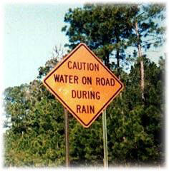
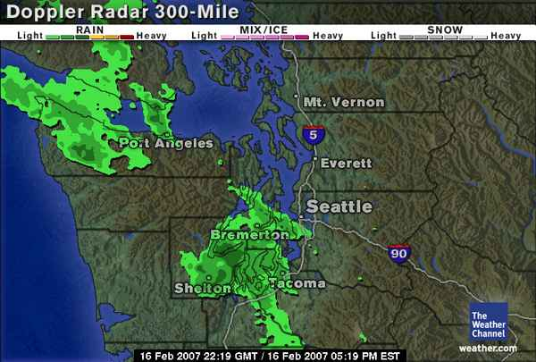




Fin
Paul Pham
Grad Student
UW Computer Science &
Engineering
Gregory Crosswhite
Grad Student
UW Physics
Thomas Decker
Postdoc
UW Computer Science
& Engineering

Slide 34
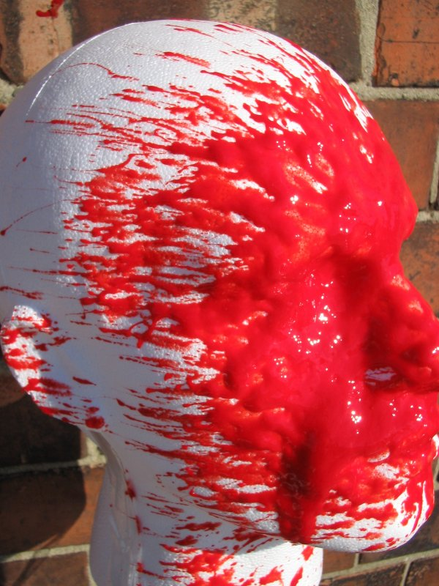
Caltech
My Early Years
The Later Years ☹

